Slide 1

Angular – Free Theme & Template
One framework. Web, Mobile & desktop.

Slide 2
Theme nổi bật
AdminLTE
CoreUI
SB Admin 2
NGX Admin
Material Dashboard Angular2 (Creative Tim)

Slide 3
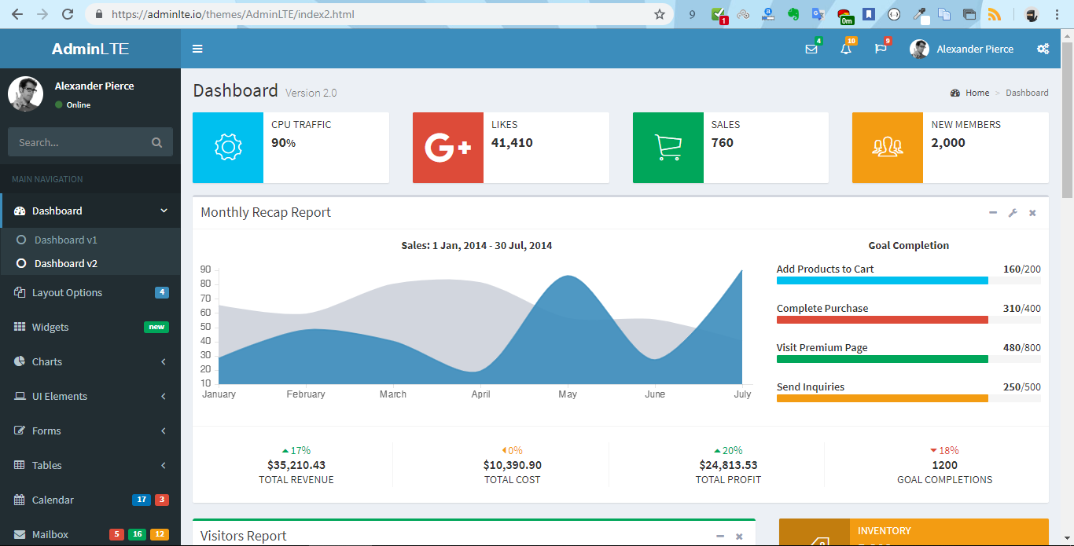

Slide 4
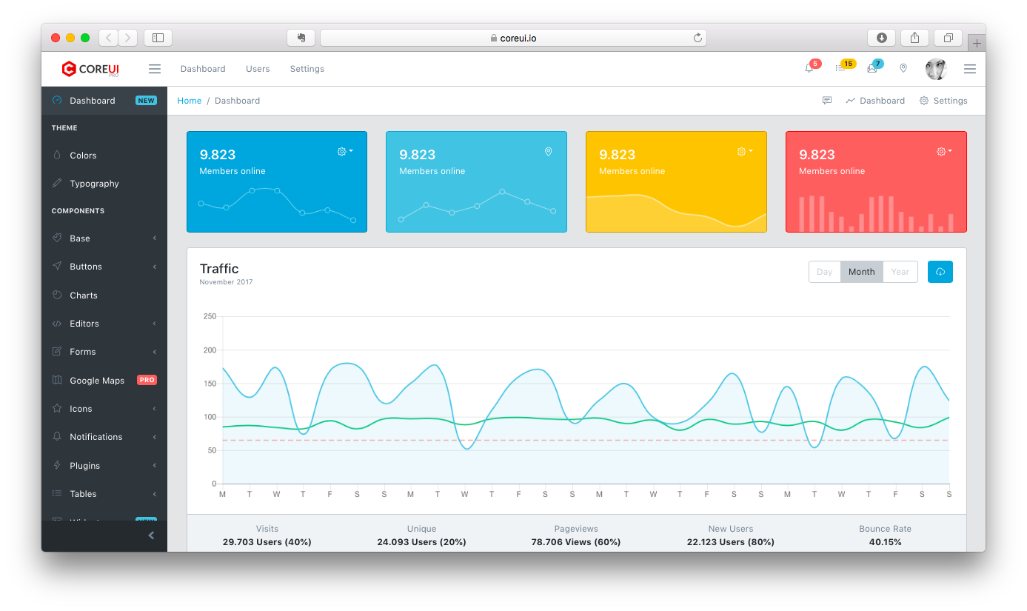

Slide 5
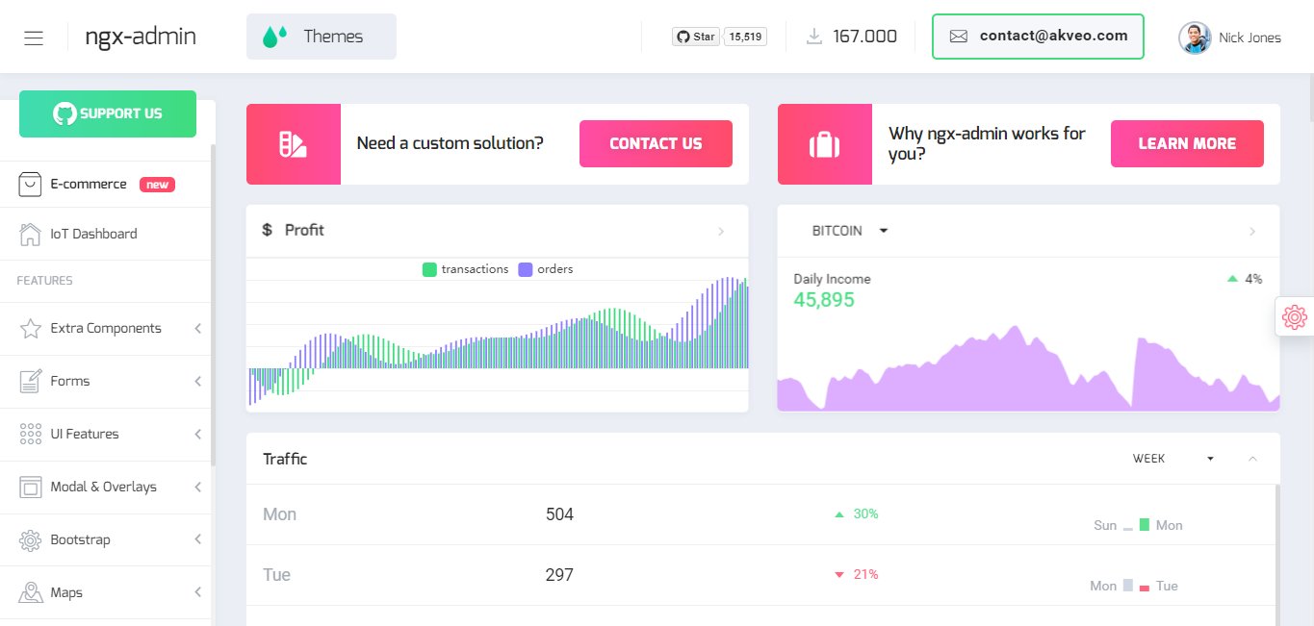

Slide 6
Repositories
https://github.com/vunb/ng-pi-admin
https://github.com/start-angular/SB-Admin-BS4-Angular-6
https://github.com/csotomon/Angular2-AdminLTE
https://github.com/codetok/cdk-admin
https://github.com/mohdrashid/PaperAdmin
https://github.com/akveo/ngx-admin
https://github.com/creativetimofficial/material-dashboard-angular2

Slide 7
References
https://startangular.com/
https://coreui.io/angular/
https://www.akveo.com/blog/top-7-nicely-looking-free-open-source-angular-projects/

